Slide 1
Master Thesis
Semantic Segmentation of Land Use with High-Resolution Orthophotos and Convolutional Neural Networks
Faculty of Mathematics and Computer Science
Karsten Köhler, Student ID No. 8690570

Slide 2
Content
Image Segmentation
Vegetation Analysis
Literature Review
Convolutional Neural Network
Reference Architectures
Dataset
Raster Preprocessing
Label Preparation
Experiments
Implementation
Metrics
Segmentation Results
Discussion
Literature Review
Spectral Vegetation Indices
Experiments
Implementation
Visualizations
Discussion

Slide 3
Research Question
Background: Emergency Landing Assistant, Emergency Landing Field Identification
Primary Objective: Semantic Segmentation of Land Use
Side Objective: Vegetation Density Analysis

Slide 4
Convolutional Neural Networks
Subset of Neural Networks
Highly efficient on grid-like data like e. g. images
Two common operations:
Convolution
Pooling

Slide 5
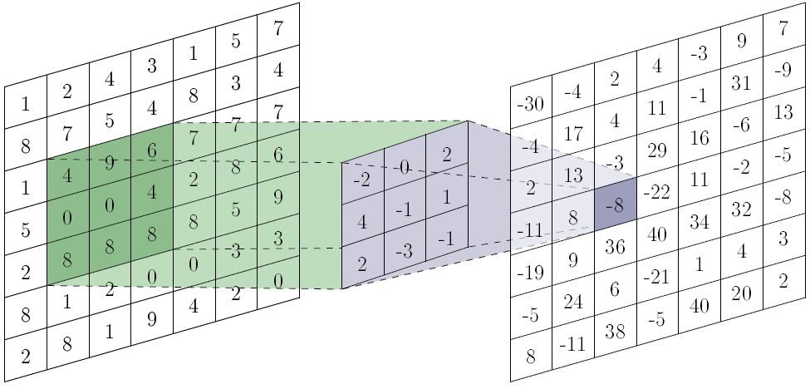

Convolution
Filter, move across image, learns shared parameters
hyperparameters: size, padding, stride
Produces convolved image (feature map)
https://towardsdatascience.com/a-comprehensive-guide-to-convolutional-neural-networks-the-eli5-way-3bd2b1164a53

Slide 6
Convolution
Multiple filters per convolution layer
Apply filters to previous feature maps
Filters can have depth
lots of computations required
Filters
Filters
Input
Feature Maps
Feature Maps

Slide 7
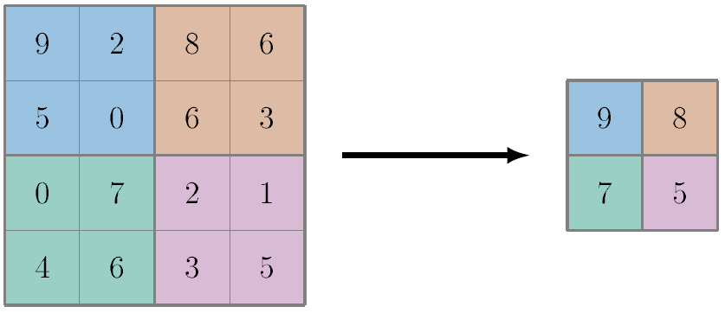
Pooling
Reduce spatial size
no trainable parameters
hyperparameters: size, padding, stride
Max Pooling

Slide 8

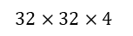
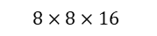
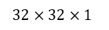
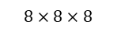
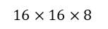
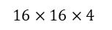
Example CNN Architecture
Alternating Convolution/Pooling Layers
Extract high-level features, computationally manageable
Only class predictions, no segmentation so far
$$32×32×1$$
$$32×32×4$$
$$16×16×8$$
$$8×8×16$$
$$1×1×k$$
$$16×16×4$$
$$8×8×8$$
Conv.
Pool.
Conv.
Pool.
Conv.
Full
Class Predictions
Input Image

Slide 9
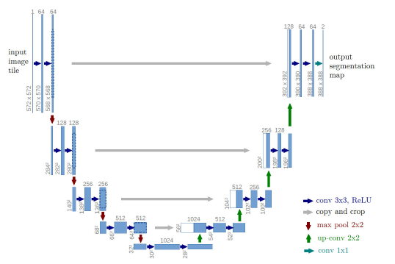
U-Net Architecture

Slide 10
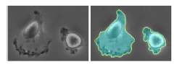
U-Net Metrics

Slide 11
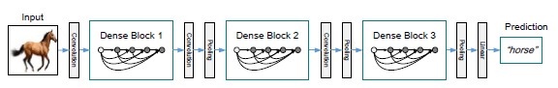
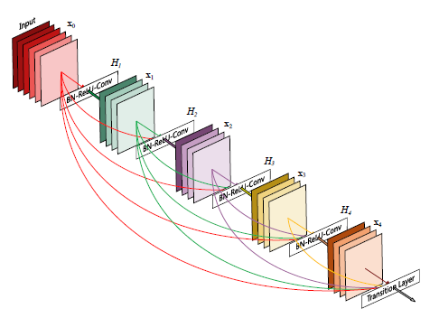
DenseNet Architecture

Slide 12
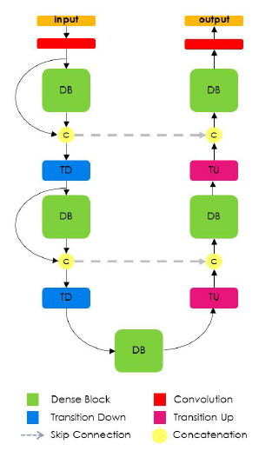
FC-DenseNet Architecture

Slide 13
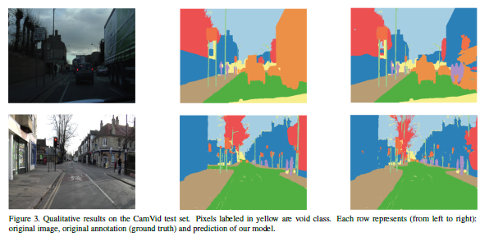
FC-DenseNet Metrics

Slide 14
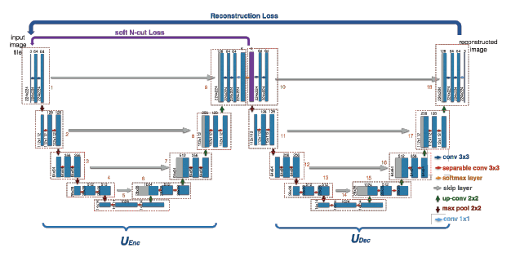
W-Net Architecture

Slide 15
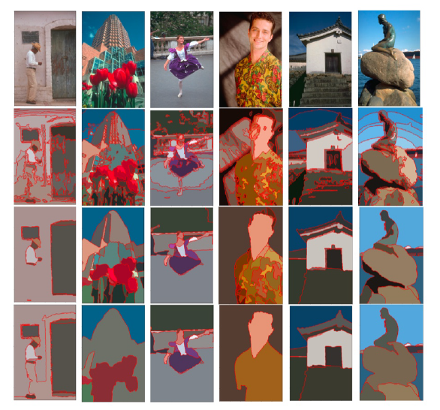
W-Net Metrics

Slide 16
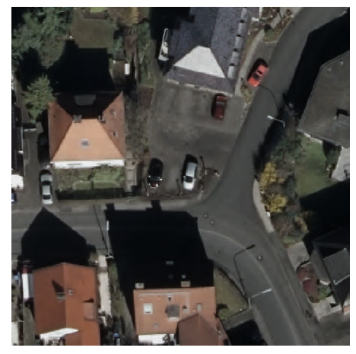
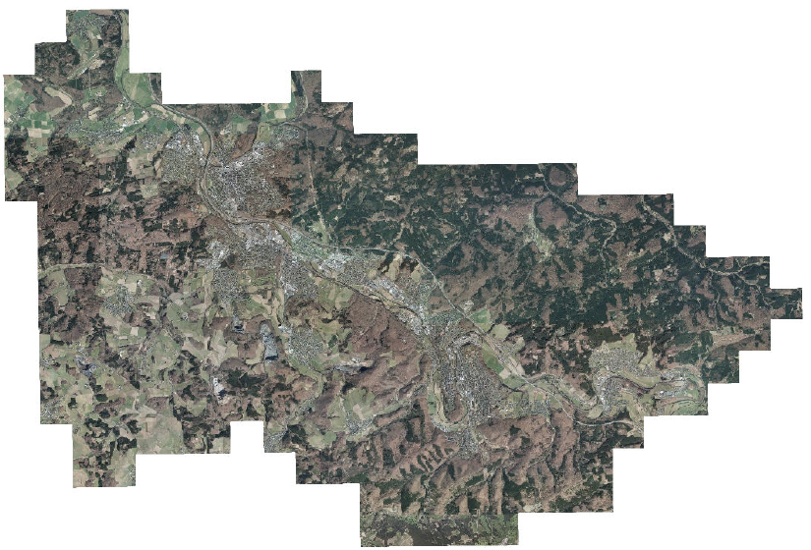
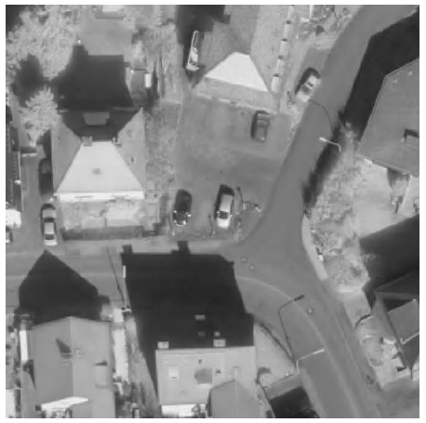
Digital Orthographic Photographs

Slide 17
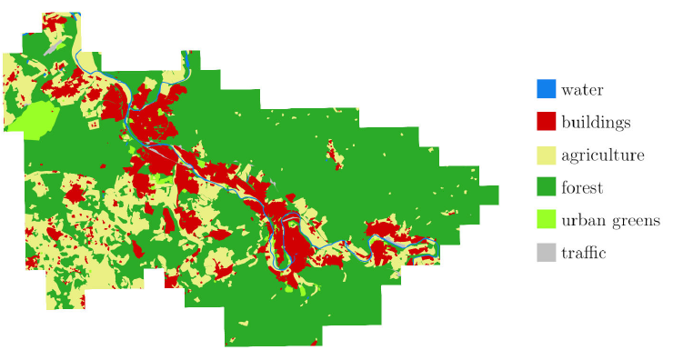
Vector Graphics with Land Use

Slide 18
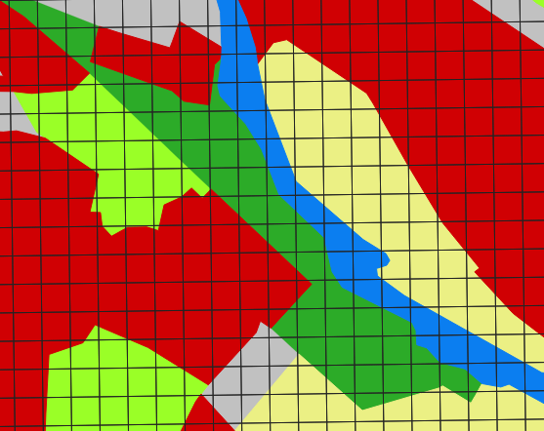
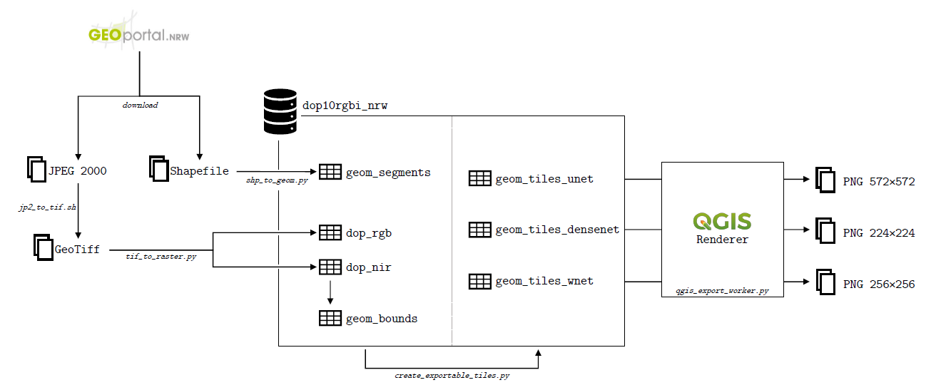
Preparations

Slide 19
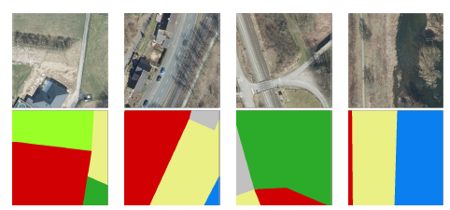
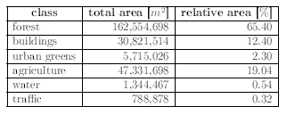
Considerations

Slide 20
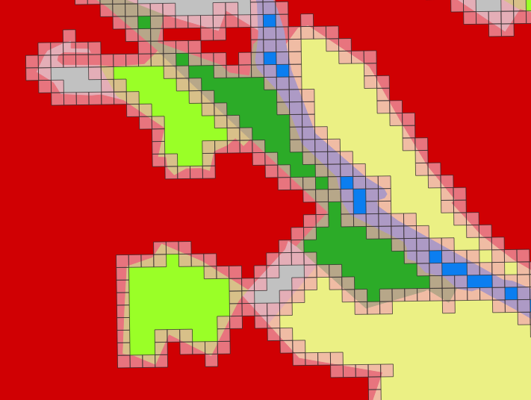
Class Imbalance
Many experiments with class weights -> no success

Slide 21
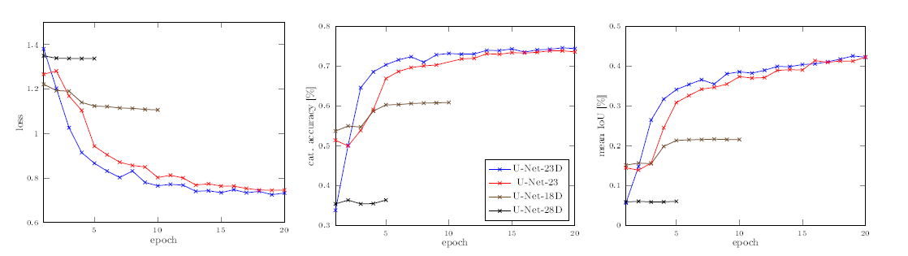
U-Net Experiments - Metrics
List configurations with variations and # of params

Slide 22
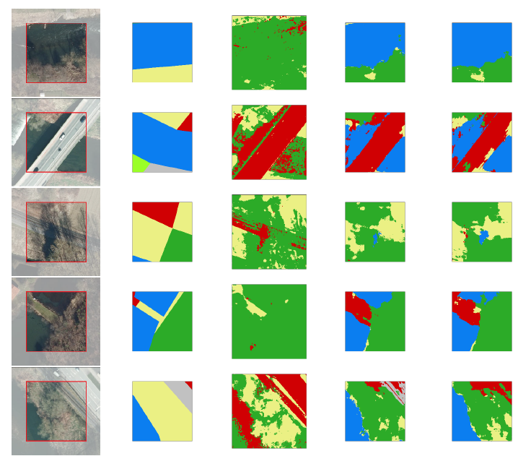
U-Net Experiments - Images

Slide 23
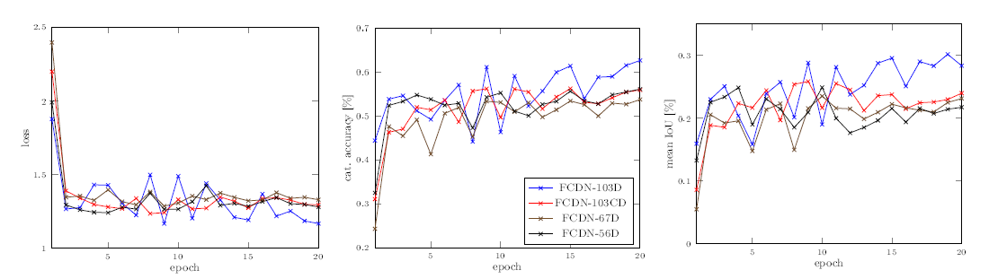
FC-DenseNet Experiments - Metrics
List configurations with variations and # of params

Slide 24
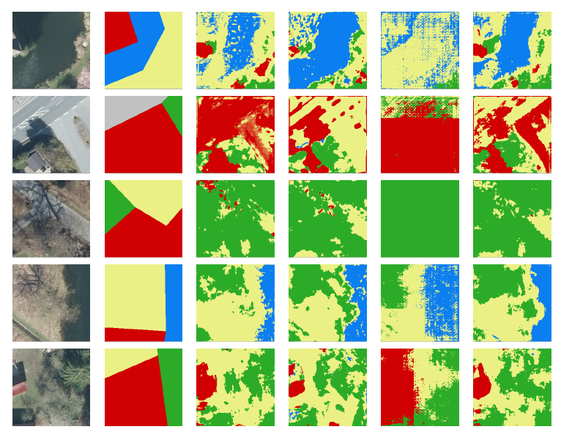
FC-DenseNet Experiments - Images

Slide 25
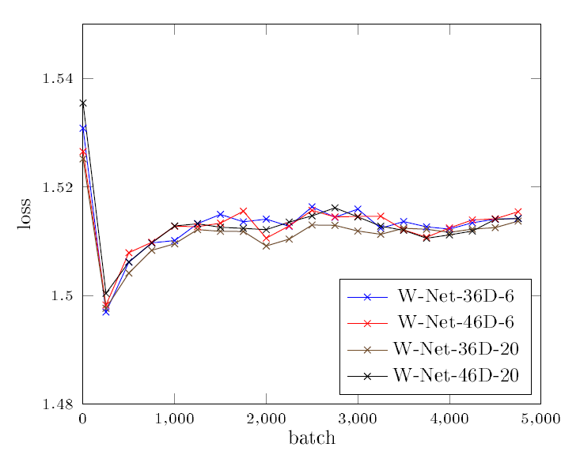
W-Net Experiments - Images
List configurations with variations and # of params

Slide 26
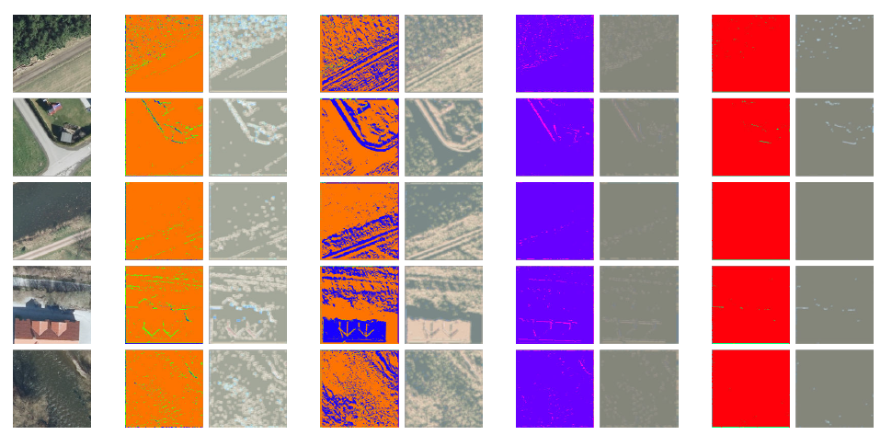
W-Net Experiments - Images

Slide 27
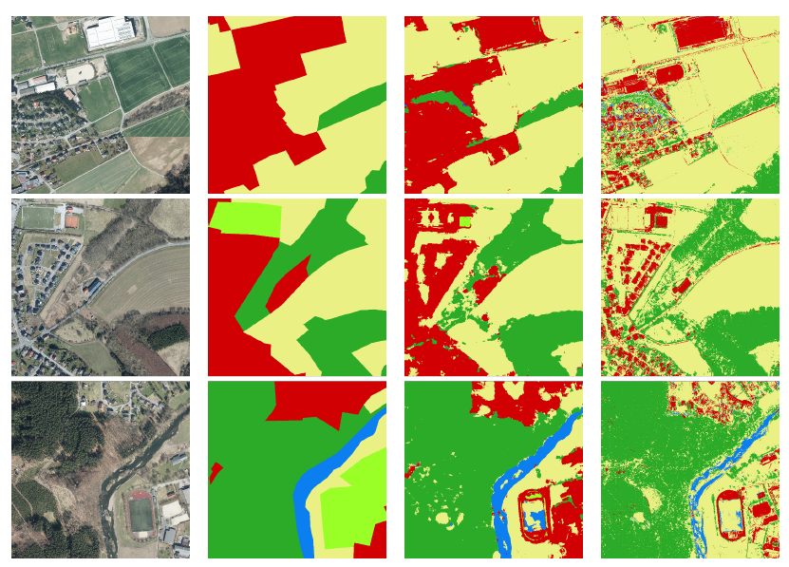
Larger Scale Images
Computation time?

Slide 28
Live Demo?
Show images, do live segmentation with U-Net and FC-DenseNet

Slide 29
Discussion

Slide 30
Vegetation Indices
Compares spectral bands of light

Slide 31
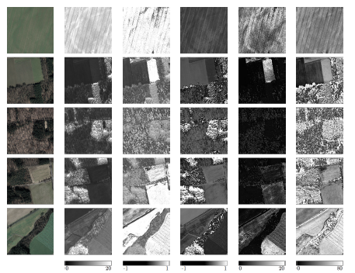
Ratio Vegetation Index

Slide 32
Normalized Difference Vegetation Index

Slide 33
Enhanced Vegetation Index

Slide 34
Soil-adjusted Vegetation Index

Slide 35
Modified soil-adjusted Vegetation Index?

Slide 36
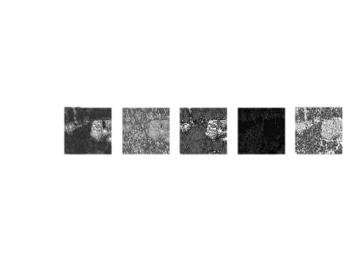
Discussion
Show different results, which one is correct?
Only green vegetation, no dead vegetation, no other obstacles
No information about height and robustness

Slide 37
Conclusion
Supervised learning was good, U-Net and FC-DenseNet can both be used, Further improvements possible
Desicion if rough or fine segmentations
Not more data, but more accurate labels, maybe other regions of world
Vegetation indices are OK, but not as standalone factor
No recommendation of which one to use, depending on sensor etc

